Slide 1

Search Engine Optimization
Report
HTTPS://WWW.AMWORLDADVISOR.COM.
TECHNICAL SEO | REPORT
AUGUST 2023

Slide 2
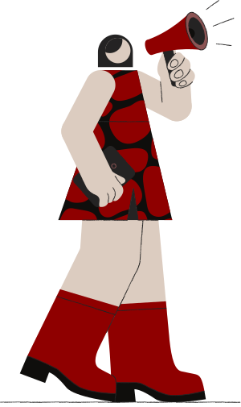
INSIGHTS AND HIGHLIGHTS FOR:
HTTPS://WWW.AMWORLDADVISOR.COM.
Report Outline
Competitor: tecnova keyword search
On-Page SEO
Off-Page Analysis
Technical Audit
My suggestions
TECHNICAL SEO | REPORT

Slide 3
Competitor Keyword Search
COMPETITOR WEBSITE AUDIT: HTTP://TECNOVAGLOBAL.COM
Tecnova Global is ranked on 502 Keywords in India
From that 57 keywords are ranking under 20 positions
Currently, you are ranking on only 2 keywords in India which are:
-Amworld
-Healthcare m&a advisors
We will help you increase this number and help you rank on keywords which have high search volume by optimizing your website content, Fixing necessary SEO issues, and optimizing your URLs.
Following is the link to the sheet which contains keywords on which http://tecnovaglobal.com is ranking
https://docs.google.com/spreadsheets/d/1ICTUtx97gv2M6wH442DlMYAyIv4fyHKN/edit?usp=sharing&ouid=105965575454039988186&rtpof=true&sd=true
From the keywords given above, not all are suitable for your firm. We will find the keywords that are suitable and which have high search volume and help you rank on those keywords.
TECHNICAL SEO | REPORT
SOCIAL MEDIA | QUARTERLY REPORT

Slide 4
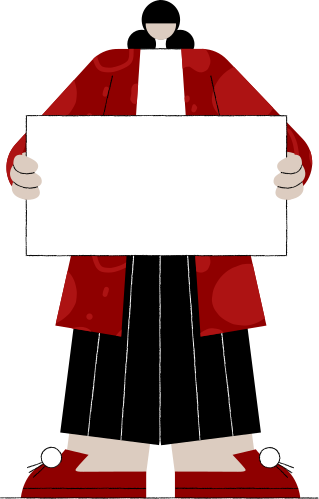


ON-Page Audit
On-Page checklist:
Meta title
Meta descriptiom
H1 tag
Sitemap.xml
Robots.txt
Image alt attributes
Google analytics
Canonical tags
Schema markup
Url optimization
User Friendly Website
Page Speed Optimization
TECHNICAL SEO | REPORT

Slide 5

Insights
Bad on-page
Your on-page is just 60 percent completed. We recommend you to first improve the UI/UX of your website because the first condition for good SEO is to have a user friendly website. Your many pages does not have meta descriptions and also need URL optimization. Each page should have one H1 tag (not more than that) but you don't have H1 tag on home page. and lastly, your website is slow.
TECHNICAL SEO | REPORT

Slide 6
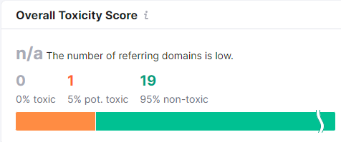
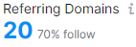
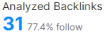
Off-Page analysis
Backlink Audit
There are very few backlinks made for the website. This means the off-page is poor. Without making backlink, SEO is incomplete. By the help of backlinks google trusts our website as our site develops referring domains, also helps in visibility. this only happens when we make backlinks on websites which has high DA-PA rankings.
TECHNICAL SEO | REPORT

Slide 7

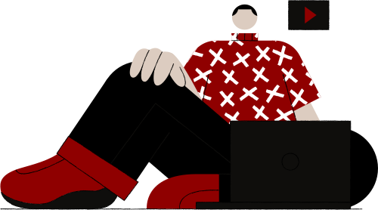
Technical Audit- Issues
TECHNICAL SEO | REPORT

Slide 8

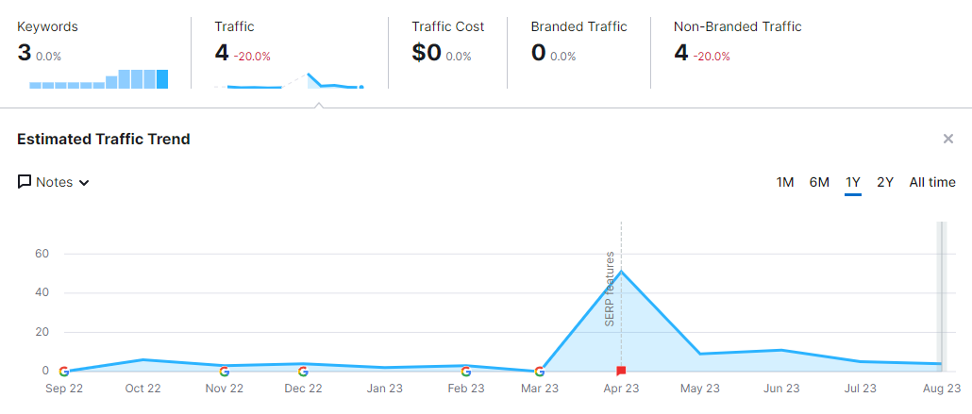
Visibility and Position
TECHNICAL SEO | REPORT

Slide 9
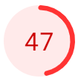
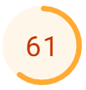
Page Speed Insights
Mobile
Desktop
Page Speed Performance on Mobile and Desktop
Both, Desktop and mobile page speed needs to be optimized. Poor page speed is not acceptable by Google and also leads to users getting irritated and leave the page without wasting time. This can be improved by minimizing the size of images and JavaScript file
TECHNICAL SEO | REPORT

Slide 10
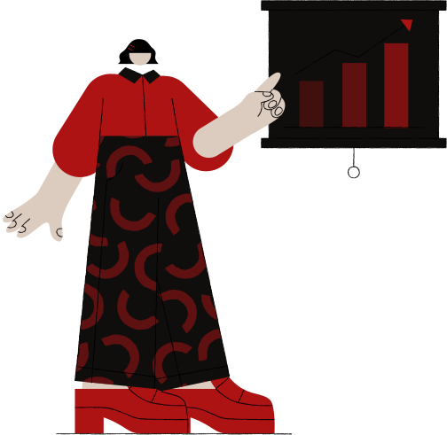
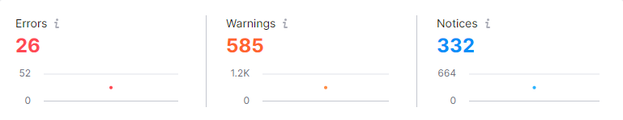
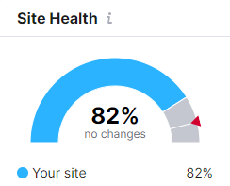
Site Audit - Technical Issues
TECHNICAL SEO | REPORT

Slide 11



Technical Issues
Errors
Warning
Notices
There are 6 errors with your site. Errors are the main problems that needs to be fixed immediately. The main error on your site is - internal links are broken and some pages are redirected to 4xx status code.
Warnings are for the issues that are potential to make your site rank go down. You need to fix them before hand and make sure no new warnings occur.
Notices are commonly not considered as issues but I recommend that your site should be up-to-date and Google friendly. This makes your site health good.
TECHNICAL SEO | REPORT

Slide 12
STRATEGIC PLAN- ONPAGE
You should complete all the On-page work 100% as Google always prefers websites that are fully optimized
Your website UI/UX should be corrected.
The content should have your keywords so that Google can know what you are and what is your site for.
Your website should be error-free.
By having your primary keywords on the meta title and description, in the H1 tag and subtitles, google can catch your site faster and can rank your site higher as it matches what the user is searching for
Always add google analytics and search console codes on your website. You can keep a record of your website performance and check how many users visit your site.
Your website speed is slow, the page speed score should be at least 80 and above.
My Suggestions
STRATEGIC PLAN
TECHNICAL SEO | REPORT
SOCIAL MEDIA | QUARTERLY REPORT

Slide 13
OFF-PAGE
STRATEGIC PLAN- OFFPAGE
Make more backlinks
Focus on high DA-PA sites for submissions
increase the number of referring domains
TECHNICAL AUDIT
STRATEGIC PLAN-TECHNICAL
My Suggestions
The number of issues are high on your website, it needs to be solved as soon as possible.
Your site health is moderate, recommended site health score is 92% and above.
Solve all the errors, warnings and notices.
Increase page load speed of your website on both mobile and desktop.
Focus more on visibility and Position.
STRATEGIC PLAN
TECHNICAL SEO | REPORT
SOCIAL MEDIA | QUARTERLY REPORT

Slide 14

Thank You
I believe to provide best quality and services to the client with long term relationships.
Thanks for giving us opportunity to work with you and your organization.
TECHNICAL SEO | REPORT
SOCIAL MEDIA | QUARTERLY REPORT
DECEMBER 2020

